Slide 1
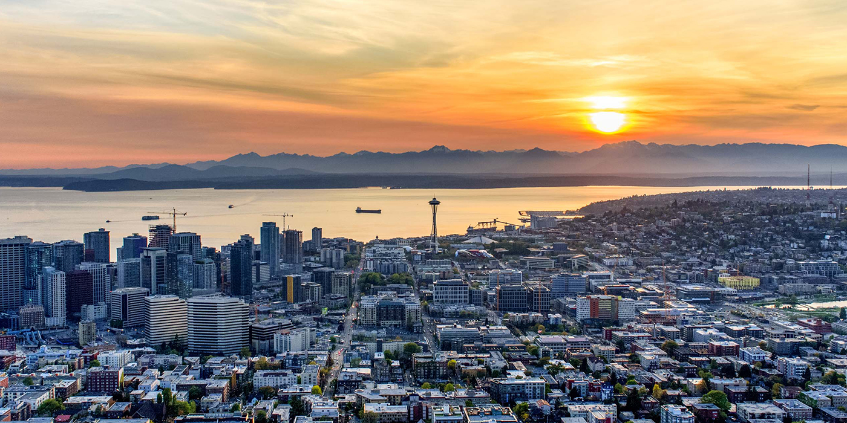
Street Use 101 and Q&A Session – Q2 2021
External Workshop
SDOT Street Use
Melody Berry
Notes:
Welcome to the SDOT Street Use Utility workshop

Slide 2
Our vision, mission, and core values
Vision: Seattle is a thriving equitable community powered by dependable transportation
Mission: to deliver a transportation system that provides safe and affordable access to places and opportunities
Committed to 6 core values:
Equity
Safety
Mobility
Sustainability
Livability
Excellence

Slide 3
Street Use 101
Portal improvements
SIP vs. SIP Lite overview
Accela basics:
How to request a change to an existing contact
How to set the permit priority
How to view invoices
How to upload a document in the application w/ live demo
How to response to corrections w/ live demo
Temporary No Park permit requirements
Date change amendment vs. job start rules
Utility permit amendment rules
Use fees overview
How to get help
Open Q&A

Slide 4
Webinar rules of conduct
Please only use the Q&A Chat to ask questions during the presentation
Any questions not answered in the Q&A Chat can be asked again in the open Q&A session at the end of the webinar
If you would like to be unmuted to ask a question, please request that in the Q&A Chat

Slide 5
Portal improvements
The new My Records page launched June 10th
The new My Records page will allow you to:
See all your records in one list
Search for records within the My Records list. You can search by address, record number, or another keyword.
Filter by Record Type, Status, and even an Action such as Pay Fees Due or Renew Application
Sort by each column heading more quickly. You can also now sort by Action.
Adjust the number of entries displayed in the table from 10 rows to 100 rows per page
Use the Select All check box to select all rows in your filtered table (not just the first page on the screen)
Download your My Records list more quickly, including a filtered view of your My Records list
To learn more, you can watch this short video by clicking this link.

Slide 6
Portal improvements – new view
If you have any issues using the new My Records page, you can email SeattleServices_ITHelp@seattle.gov
There will also be a feedback survey available through the end of summer

Slide 7
SIP vs. SIP Lite overview
Full Street Improvement Permit (SIP) process:
Notes:
SIP reviews have three review phases: Conceptual Review, Design Guidance, and Formal Review and Pre-con. One review cycle includes the Screening, Primary Reviewer, Secondary Reviewer(s) (if applicable) and Review Evaluation steps for each review phase.
SIP Reviews follow the below steps. Due to the complexity of this review process, the Conceptual Review, Design Guidance, and Pre-Con review phases do not show all review cycle steps.

Slide 8
SIP Lite
Streamlined review process for small scale ROW improvements
Shorter timeline
No Design Guidance meetings
Reduced number of review cycles
Reduced plan requirements
Reduced permit issuance fee (Will be effective end of 2021)

Slide 9
SIP vs. SIP Lite overview
SIP Lite process:
Notes:
SIP reviews have three review phases: Conceptual Review, Design Guidance, and Formal Review and Pre-con. One review cycle includes the Screening, Primary Reviewer, Secondary Reviewer(s) (if applicable) and Review Evaluation steps for each review phase.
SIP Reviews follow the below steps. Due to the complexity of this review process, the Conceptual Review, Design Guidance, and Pre-Con review phases do not show all review cycle steps.

Slide 10
Projects Suitable for SIP Lite
Land Use Code required curb ramps (corner lot curb ramp triggers)
Small scale frontage improvements along with corner curb ramps (e.g. sidewalks, street trees, driveways) <2,000 SF
Small scale alley improvements < 2,000 SF*
Voluntary street improvements < 2,000 SF
Infill development (mid-block where there is established curb and gutter on either side of the street)
Curb ramps triggered due to post construction activity
Existing alley widening more than 2 feet.
*Additional information such as full survey may be needed (similar requirement as regular SIP application)

Slide 11
Projects under normal SIP
Land Use Code required streets improvements (new curb, sidewalk, etc.)
New or modifications to existing storm/water/sewer main
Improvements to unimproved streets and alleys
New paving/ road widening projects
>2,000 SF of new plus replaced impervious surface improvements
Projects with Green Factor elements in the ROW
Major projects for CSO reductions (GSI, storm detention, etc.)
Major interagency transportation projects such as Link Light Rail extensions
Plat review (full and unit lot subdivisions)

Slide 12
Summary
 | SIP | SIP Lite
Project Scope | > 2,000 SF | < 2,000 SF
Review Time | 6 months to 2 years + | 4 - 6 months +
Issuance Fee | $4,815 | Reduced fee (Pending)
Review fee | Hourly | Hourly
Submittal Requirements | Current Standards | Reduced Requirements
DG Meetings | Required | Not required

Slide 13
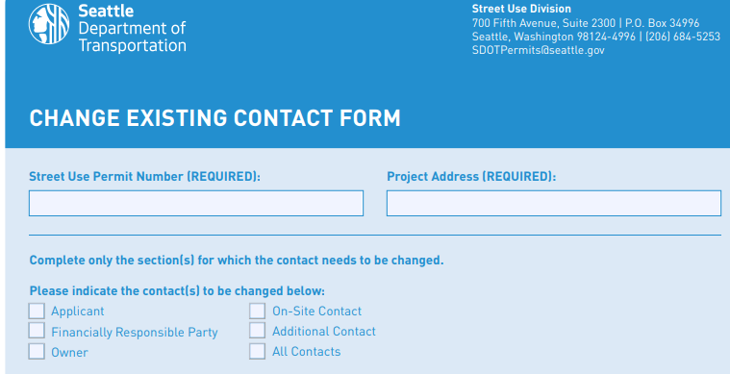
How to request an existing contact change
Contact changes after permit issuance can be requested by applying for a Revision Amendment
Complete and upload the Change Existing Contact Form to your Revision Amendment

Slide 14
Revision amendment application steps
Select Revision Amendment Type
Review Parent Application Information
Enter Amendment Description
Extend and/or Add Use(s)
Upload Docs
Review Application
Information
Submit & Thank You

Slide 15
Revision amendment overview
The Revision Amendment can be used to request one or more of the following:
Contact change(s)
Address change
Related information change(s) (e.g., 24-hour contact, restoration party etc.)
Scope of work change(s) (e.g., new and/or revised use types and areas)
Extend the end date of a use(s)
Notes:
We will look at what the applicant sees when they initiate a Revision Amendment in the Seattle Services portal.

Slide 16
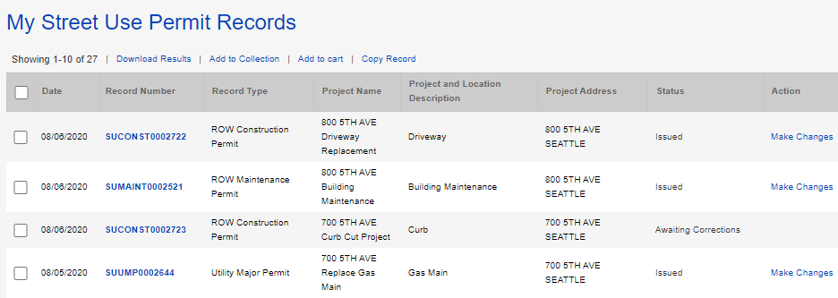
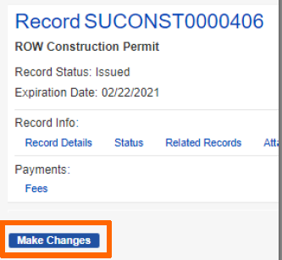
How to apply for a Revision Amendment
If the permit is in the Issued stage, under Action, Click on the Make Changes link
From the individual record, click on the Make Changes button
1
2
Notes:
Once an application has been reviewed and approved, the customer receives an email letting them know the permit is ready to issue and waiting for payment. Fees can be paid online. Online payment only allows full payment and only credit cards.
Remember, for billed customers, the permit is issued without payment.
If it’s a free permit, the customer receives an email stating that the permit has been issued and is ready for printing.
Now let’s look at the Fees tab on the record.

Slide 17
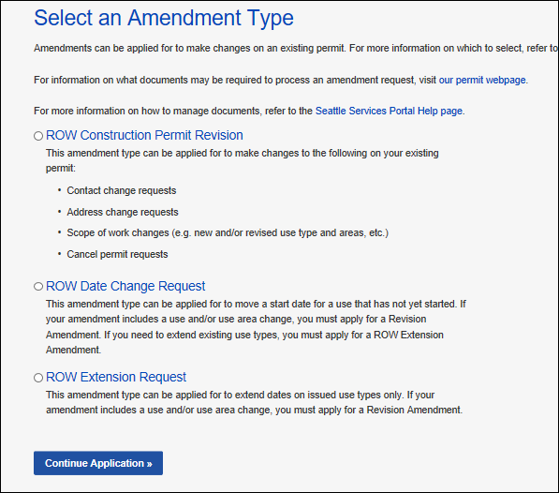
How to apply for a Revision Amendment
Select the Revision Amendment type
Click the Continue Application button to start the amendment application process
3
4

Slide 18
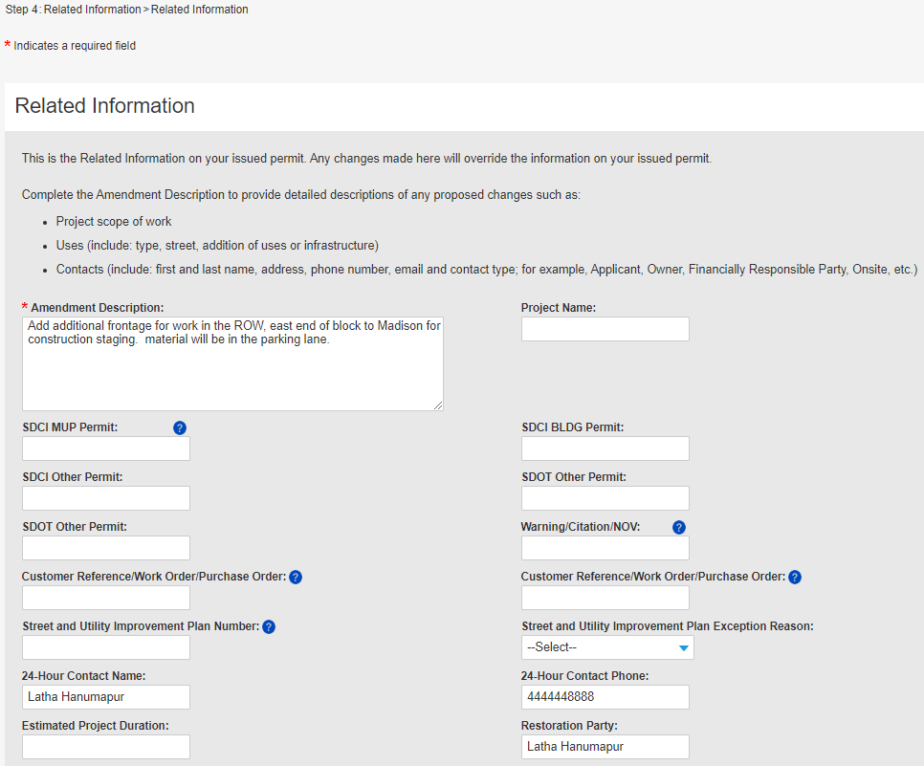
How to apply for a Revision Amendment
In the Related Information section (Step 4), enter what contact changes are needed in the Amendment Description
Tip: Since you can’t update read-only fields, add all the information you want to change in the Amendment Description.
4
Need to change the FRP contact per the attached Change Existing Contact Form.

Slide 19
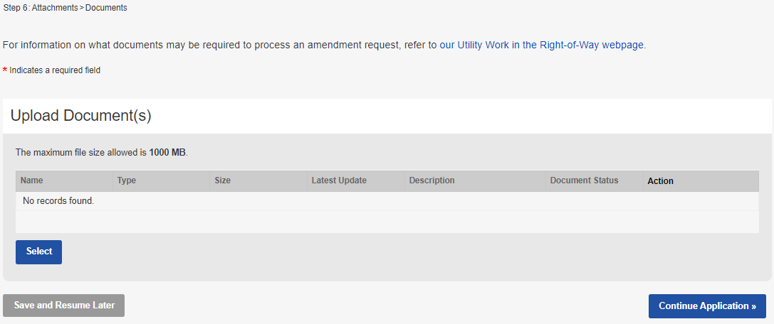
How to apply for a Revision Amendment
In the Attachments section (Step 6), upload the Change Existing Contact Form:
Click on the Select button
Choose the desired document from your computer
From the Document Type drop-down menu, select the type of document you are uploading
Tip: For us to perform efficient plan review, only upload flattened PDF documents.
Add a description (optional)
Click the Save button
To upload another document, click the Select button
To move to the next step, click on the Continue Application button
a
c
g
d
e
f
Notes:
After the use information has (optionally) been entered, the Upload Documents page displays. The applicant is not required to upload any documents in order to submit an amendment.
But depending on the nature of the change requested, the applicant may already know that additional documents will be required. OR, the SU Reviewer may determine that documents are needed and request them during review.
The last page in the SSP amendment process is the Review page, just like the application, this allows the applicant to review the information they’ve entered and also to go back and make additional or different changes to sections which are editable.

Slide 20
How to set the Permit Priority
We have a new Permit Priority section in the Related Information (Step 4) page of the application
If the work supports one of the below priorities, select the corresponding permit priorities in this section:
Emergency response – Emergency
In support of a SDOT or other Transportation Project – Critical
In support of an Office of Housing approved 100% Affordable Housing project – Affordable Housing

Slide 21
How to view invoices
For fees that are billed, such as review and inspection charges, invoices are created at the beginning of each month and an email is sent to the person identified as the Financially Responsible Party
To access invoices, two things are required:
You must have a Seattle Services Portal account
You must be identified as the Financially Responsible Party. Only the Financially Responsible Party, or a user they have delegated permissions to, has access to the invoice.

Slide 22
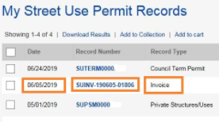
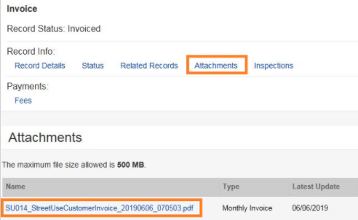
How to view invoices
From your My Records Page, look for a Record Type of Invoice and a Date in the current month. The date indicates the date the invoice was generated. A date in June, for example, is for May fees.
Click on the blue link under Record Number. You can find the invoice document in the Attachments tab.
Instructions on how to access the invoice document can be found in this help article: How to Find and Pay Your Current Street Use Invoice
The invoice is also mailed to the address on record

Slide 23
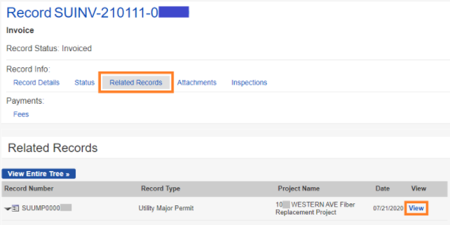
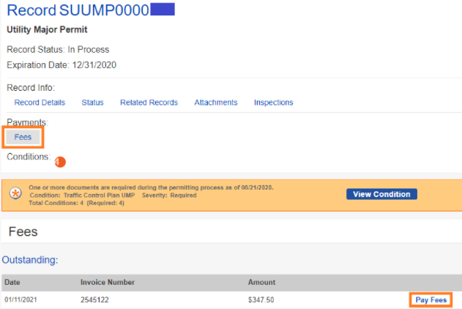
How to view invoices
Even if you are not the Financially Responsible Party, you can see which permit(s) is tied to an invoice by searching on the Invoice record and clicking the Related Records tab.
Then click on the View link to go to the related permit
To pay fees, click on the Fees button and then the Pay Fees link
Unpaid fees for this record are displayed. Click the Check Out button to add the fees to your Cart.

Slide 24
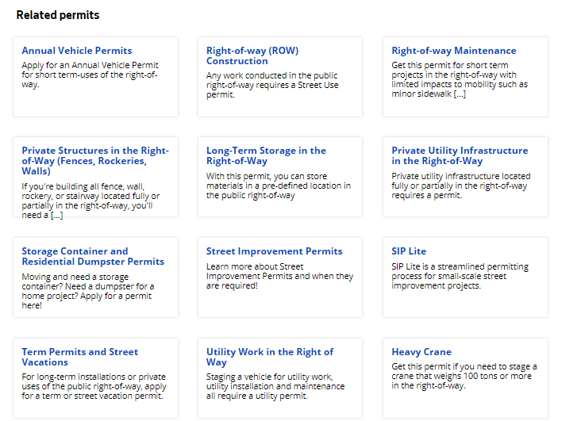
How to upload a document in the application
Determine what documents are required for your permit type on the corresponding website found at http://www.seattle.gov/transportation/permits-and-services/permits
Develop the required documents per the requirements referenced on the permit type website
Start the application process on the Seattle Services Portal

Slide 25
How to upload a document
In the Attachments section (Step 6) of the application, upload all required documents:
Click the Select button
Choose the desired document from your computer
From the Document Type drop-down menu, select the type of document you are uploading
Tip: For us to perform efficient plan review, only upload flattened PDF documents.
Add a description (optional)
Click the Save button
To upload another document, click the Select button
a
c
d
e
f
Notes:
Optionally, if there is an exact match, there will not be

Slide 26
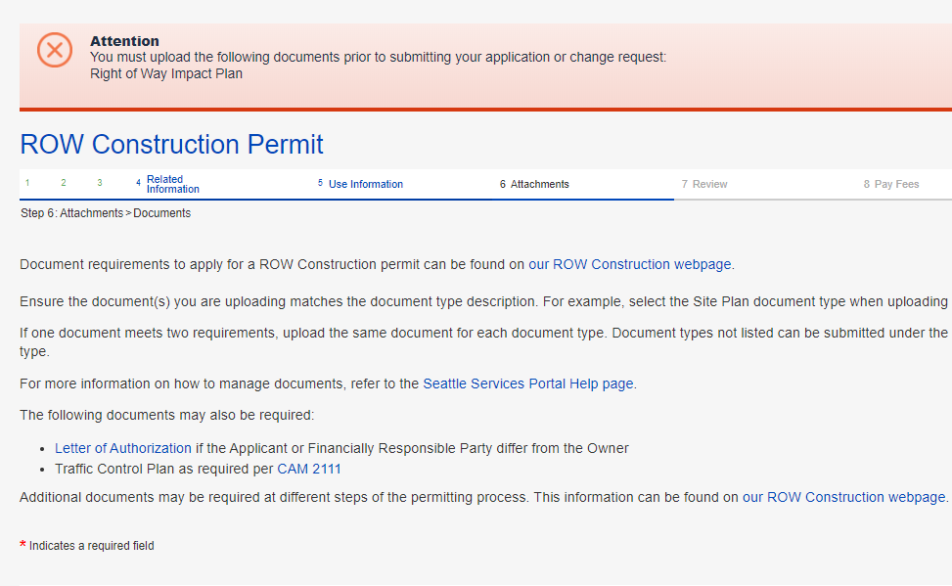
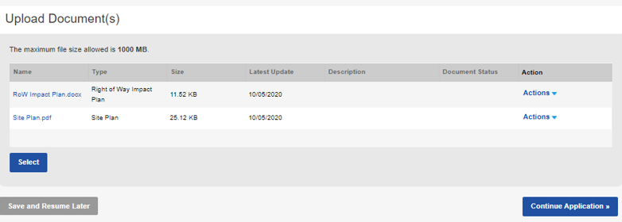
How to apply for a construction permit
How to upload a document in the application
If you click Continue Application before all required documents are uploaded, this banner will turn red alerting you what documents are still required to upload.
Once all required and desired documents are uploaded, click the Continue Application button
22
Notes:
Optionally, if there is an exact match, there will not be

Slide 27
How to upload a document in the application
Live demo!

Slide 28
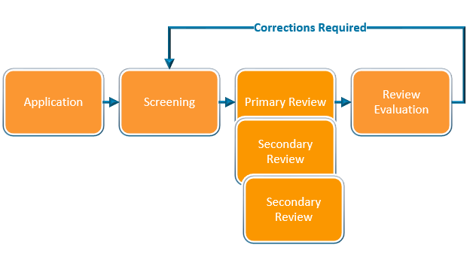
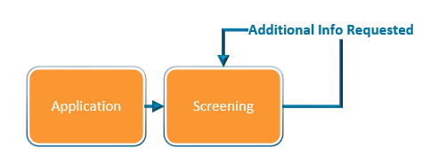
How to respond to corrections
Corrections can be required in the Screening or Review Evaluation task
At Screening, the task status will change from In Process to Additional Info Requested
At Review Evaluation, the record status will change from In Process to Awaiting Corrections

Slide 29
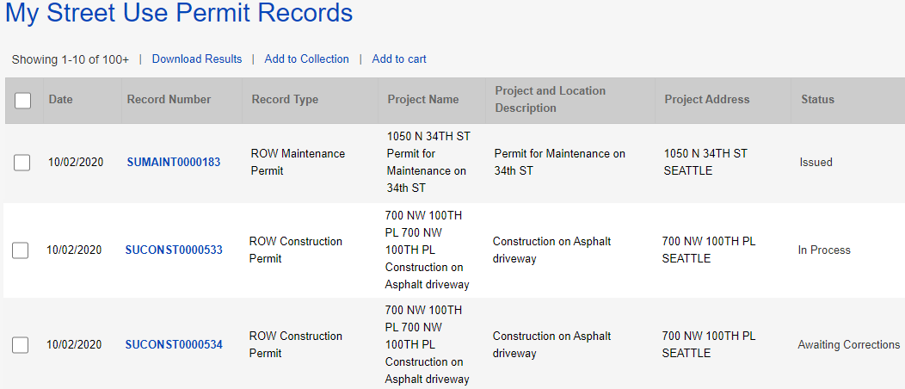
How to respond to corrections
From the My Records page, the Status of the permit will show as Awaiting Corrections
Click on the blue hyperlink permit number
1
2

Slide 30
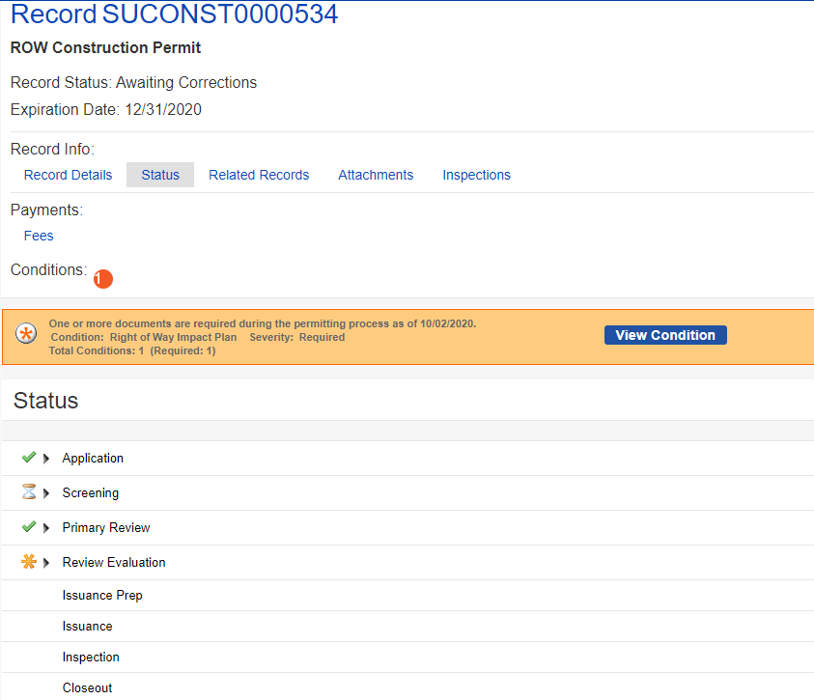
How to respond to corrections
Click on the Status tab
The red banner will indicate what document is required
Click on the View Condition button for more information about each document/condition
The Review Evaluation task shows an asterisk indicating there has been at least one corrections cycle
The Screening task shows as In Process with the hourglass because that is the beginning of the review process
3
b
a
c
d

Slide 31
How to respond to corrections
Required conditions can be found by clicking on the View Condition button on the record
Conditions that are marked as Update Required or Pending must have a document type of the name of that condition uploaded to satisfy that condition
There are some conditions that may be required later in the review process (e.g., indemnity agreement, insurance etc.).

Slide 32
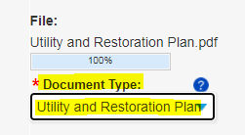
How to respond to corrections
To satisfy the Utility and Restoration Plan condition, you must upload a document type of Utility and Restoration Plan
To upload a document, click on the Attachments tab of the record and click the Select button
After you select the correct document from your computer, make sure you select the document type that matches the condition name
Repeat until a document is uploaded for each required condition

Slide 33
How to respond to corrections
After you upload a document that matches each required condition, the record status should change from Awaiting Corrections to Corrections Submitted
If the record status does not change to Corrections Submitted, double check that all conditions have been met. If you are still having trouble, email our support team at dot_su_ssportal_questions@seattle.gov
Below are helpful articles on this subject:
How to Find the Status of a Record
What Does the Banner (Conditions of Approval) on My Record Mean
How to Respond to Street Use Corrections

Slide 34
How to respond to corrections
Live demo!

Slide 35
Temporary No Park requirements and process overview
If work is removing paid parking from the public, SDOT recovers the lost revenue for those removed spaces through a Temporary No Park (TNP) permit
Street Use permits have a new requirement to ensure a TNP permit is applied for before we issue our permit when paid parking is removed
To satisfy the Temporary No Parking Confirmation condition on your Street Use permit, you must upload one of the following documents:
A copy of the Application Received email
A screen image of the application record details page
A copy of the permit
A copy of a signed billing agreement
A copy of an email from Traffic staff indicating no reservation needed
TNP permits can be applied for only up to 90 days in advance of your start date

Slide 36
Date Change Amendment rules
New Use Start Date
Issued End Date or Permit Expiration
Issued Use Start Date
A Date Change Amendment is required when the start date needs to move before the issued use start date
Notes:
Job Start reschedules must be 2 business days in advance

Slide 37
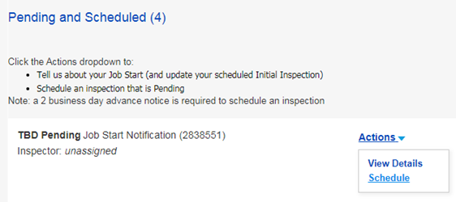
Job start rules
The Job Start Notification can be scheduled or re-scheduled through the Seattle Services Portal
The Job Start Notification schedules the Initial Inspection
Instructions on how to schedule or re-schedule the Job Start Notification can be found on this help article: https://seattlegov.zendesk.com/hc/en-us/articles/360057058453-How-to-Provide-or-Reschedule-a-Street-Use-Job-Start-Notification

Slide 38
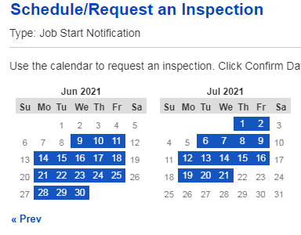
Job start rules
For non-utility permits, the job start can only be scheduled 30 business days from the day you are scheduling

Slide 39
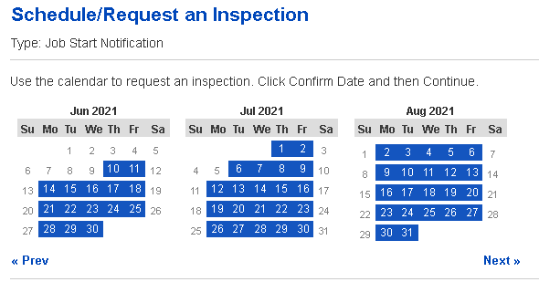
Job start rules
For utility permits, the job start can only be scheduled through the permit expiration date (As of June 10th)

Slide 40
Job start rules
Initial Inspection Scheduled 5 Bus Days After Issued Start Date
Issued End Date or Permit Expiration Date
Issued Use Start Date
If the Job Start Notification is not scheduled, the Initial Inspection will automatically schedule 5 business days after the issued start date
After the Initial Inspection has been completed, the Job Start Notification is no longer available to schedule or re-schedule on the Seattle Services Portal
To re-schedule the Initial Inspection, email the assigned inspector
Notes:
Job Start reschedules must be 2 business days in advance

Slide 41
Utility permit amendment rules
Work is taking place before the issued use start date
Requires a Date Change Amendment
Work is extending beyond the issued duration
Requires an Extension Amendment
Work is taking place beyond the Permit Expiration Date
Requires an Extension Amendment
Scope of work changes (e.g., new use, change in area), contact changes etc.
Requires a Revision Amendment
Notes:
Job Start reschedules must be 2 business days in advance

Slide 42
Utility permit amendment rules – Date Change Amendment
New Use Start Date
Issued Use Start Date
Permit Expiration Date
A Date Change Amendment is required when the start date needs to move before the issued use start date
Notes:
Job Start reschedules must be 2 business days in advance

Slide 43
Utility permit amendment rules – Extension Amendment
Issued Duration
Issued Use Start Date
Actual Duration
Permit Expiration Date
Work is extending beyond the issued duration
Requires an Extension Amendment
In Hub areas, requires Hub coordination documented in dotMaps
Notes:
Job Start reschedules must be 2 business days in advance

Slide 44
Utility permit amendment rules – Extension Amendment
New Start Date
Issued Use Start Date
Permit Expiration Date
Work is taking place beyond the permit expiration date
Requires an Extension Amendment
In Hub areas, requires Hub coordination documented in dotMaps
Notes:
Job Start reschedules must be 2 business days in advance

Slide 45
Use Fee Overview
What are 'Use Fees’?
How are use fees calculated
How to Estimate Use Fees
Ways to keep Use Fees down
Notes:
For presentation only classes

Slide 46
What are 'Use Fees'?
Use Fees are charges for SDOT area used during the project/construction
E.G. A 100'x5' area of sidewalk closed to public during demolition. Use Fees are charged for the area and duration of that sidewalk closure.
Definition found Online: Use fees are what SDOT charges permit holders for the square footage area of the right-of-way that they use short-term for non-transportation uses. Use fees are charged in addition to permit and hourly (review or inspection) fees.
Use fee equation (Cost per day) –
(Sum of Fee Factors) x (Square Footage of occupied space/100) x (Escalation Rate aka RSD)
Notes:
For presentation only classes

Slide 47
Determining “Fee Factors”
Location Base Factor
(Urban Village, Urban Center)
Street Type
(Arterial, Non-Arterial, or Alley)
Mobility Impact
(Pedestrian, Bike, Transit Impacts) $1,105.00 of 'Use Fees'
Use fee equation (Cost per day) –
(Sum of Fee Factors) x (Square Footage of occupied space/100) x (Escalation Rate aka RSD)
Notes:
For presentation only classes

Slide 48
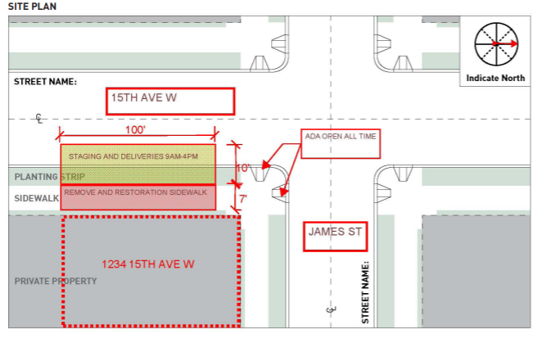
Square Footage – Right of Way Impact Plan
The Square footage of area being used for staging, materials, and construction in the Right-of-Way.
This information and document are required for every permit type
In the calculation of fees, the area is rounded up to the nearest 100 sq. ft.
Use fee equation (Cost per day) –
(Sum of Fee Factors) x (Square Footage of occupied space/100) x (Escalation Rate aka RSD)

Slide 49
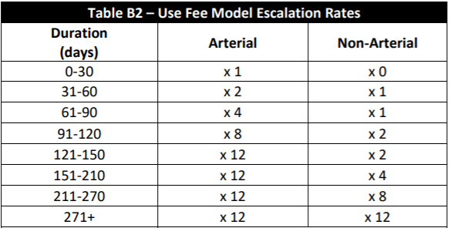
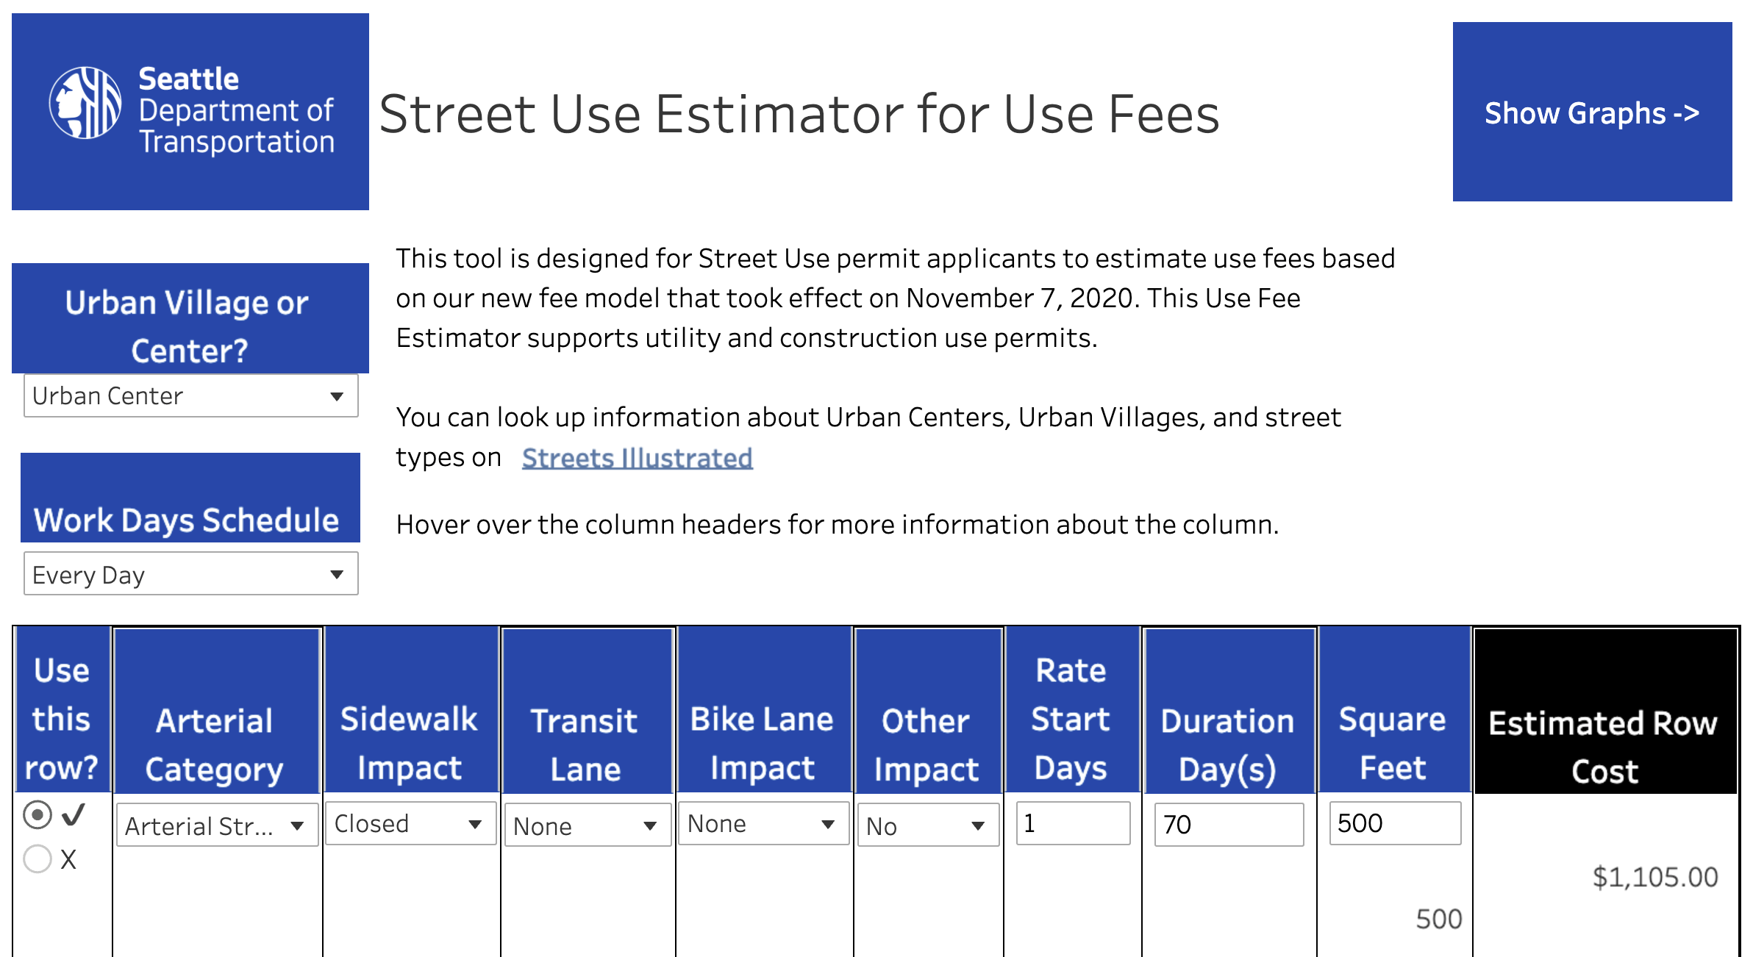
What are Rate Start Days (RSD)? What are Escalating Fees?
Use fee equation (Cost per day) –
(Sum of Fee Factors) x (Square Footage of occupied space/100) x (Escalation Rate aka RSD)
Notes:
I figure on this one you can just explain it – rather than have specific text.
The figure on the left is what comes up when you press the 'Show Graphs' button.

Slide 50
Open Q&A

Slide 51
Questions?
Melody.Berry@seattle.gov
www.seattle.gov/transportation

